Slide 1
Mass Drug Administration (MDA)
COVID-19 Training Module
Presenter Name
Event, Location
Date
World Health Organization, 27 July 2020. https://www.who.int/publications/i/item/WHO-2019-nCoV-neglected-tropical-diseases-2020-1
Notes:
This can be adapted for pre-TAS or TAS. This also should be adapted to country context and country COVID guidance.

Slide 2
About this resource
This is a generic module based on the Practical Approaches to Implementing WHO Guidance for Neglected Tropical Disease (NTD) Programs in the Context of COVID-19: Mass Drug Administration (MDA).
It is intended to be adapted to local context and situations.

Slide 3
TRAINING
Notes:
Some of these slides could be used in the main training (e.g. norms), while others might not make sense for the main training.
Some of the slides might be useful to present in the main training if the trainees will be responsible for cascading the training to lower levels.

Slide 4
Norms during in-person trainings
Screening
Hand-Washing
Safety
Persons experiencing COVID-19 symptoms or have come into contact with a COVID-19 case should NOT participate.
All trainees should wash hands upon arrival and whenever appropriate during training ie. touching a contaminated surface.
Eating and drinking during training should be avoided. Equipment and surfaces should be disinfected at least twice daily.
Masks
Social Distancing
Masks should be worn at all times by both trainers and trainees.
All participants should maintain at least a 2 meters distance from others.

Slide 5
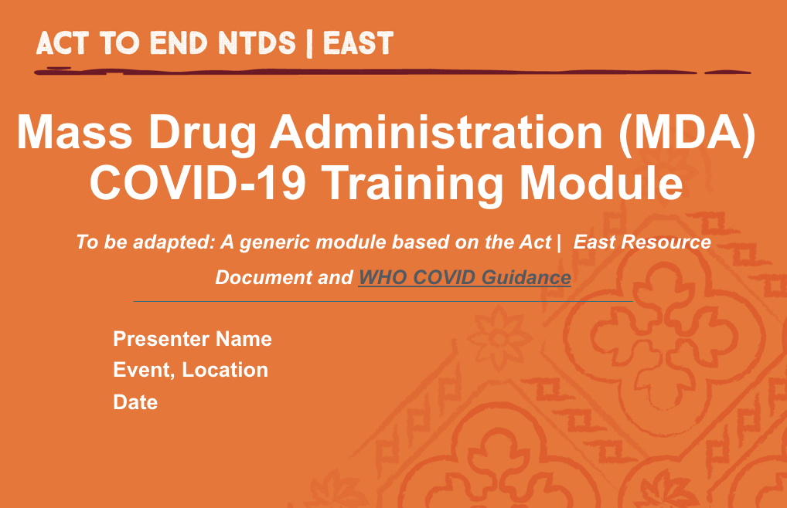
Virtual trainings
Preferred method of training is Virtual:
  Live Web-Based Training if internet available
  Recorded trainings and FAQ that can be distributed via CD, USB, or mobile application
Since Virtual Trainings have not been the norm, experimentation is necessary to find the best methods that work for MDA team
Notes:
Use for higher-level trainings

Slide 6
In-person training guidelines
If in-person trainings must take place, then the following guidelines should be observed:
  Head trainer or supervisor should screen all trainees for COVID-19 signs and symptoms upon arrival. Anyone with symptoms or at high-risk should not participate.
  Avoid delays between training and field implementation
  Trainings should preferably be conducted outdoors, otherwise ensure good ventilation e.g. with open windows
  Wash stations should be available at every training
Notes:
Use for higher-level trainings

Slide 7
Additional equipment list for in-person trainings
Masks for all participants and trainers
Disinfectant for wiping surfaces (use 70-90% ethanol/ethyl alcohol for equipment and sodium hypochlorite at 0.1%/1000ppm for surfaces)
Handwashing Water/Soap or Hand Sanitizer
Disposable Paper Towels
Dust Bin
COVID-19 signs and symptoms checklist for screening of all participants
Notes:
Use for higher-level trainings

Slide 8
COVID-19 GENERAL INFORMATION

Slide 9
What is COVID-19?
COVID-19 Virus
COVID-19 is the infectious disease caused by the most recently discovered coronavirus
This new virus and disease were unknown prior to the start of the outbreak in December 2019
World Health Organization, 17 April 2020. https://www.who.int/emergencies/diseases/novel-coronavirus-2019/question-and-answers-hub/q-a-detail/q-a-coronaviruses

Slide 10
Is there a vaccine, drug, or treatment for COVID-19?
While some Western, traditional, or home remedies may provide comfort and alleviate symptoms of mild COVID-19, there are no medicines that have been shown to prevent or cure the disease
There is no vaccine available yet for COVID-19
World Health Organization, 17 April 2020. https://www.who.int/emergencies/diseases/novel-coronavirus-2019/question-and-answers-hub/q-a-detail/q-a-coronaviruses

Slide 11
Screening for COVID-19 symptoms
Most Common Visible Symptoms suggestive of COVID-19:
Red Eyes
Fever
Dry Cough
Nasal Congestion
Shortness of Breath
World Health Organization, 2020. https://www.who.int/health-topics/coronavirus#tab=tab_3.

Slide 12
How serious is COVID-19?
Most people (about 80%) recover from the disease without needing hospital treatment.
Around 1 out of every 5 people who gets COVID-19 becomes seriously ill and can develop serious symptoms such as:
  Difficulty breathing or shortness of breath
  Chest pain or pressure
  New confusion, or loss of speech and movement
  Death
World Health Organization, 8 March 2020. https://www.who.int/indonesia/news/detail/08-03-2020-knowing-the-risk-for-covid-19

Slide 13
High-risk groups
Older individuals typically over 60 years old
COVID-19 can be still be a serious illness for all age-groups
Those with underlying medical problems such as:
  High Blood Pressure
  Heart and Lung Problems
  Diabetes
  Cancer
World Health Organization, 2020. https://www.who.int/westernpacific/emergencies/covid-19/information/high-risk-groups

Slide 14
How does COVID-19 spread?
Primarily from Person-to-Person through small droplets from the nose to mouth
  Expelled when a person with COVID-19 speaks, coughs, or sneezes
Most people get sick about 5 days after exposure
  Although COVID-19 can live in the body for a period of 2 to 14 days before signs of illness appear
Some people, especially children, can be infected and not show any signs of illness
World Health Organization, 17 April 2020. https://www.who.int/emergencies/diseases/novel-coronavirus-2019/question-and-answers-hub/q-a-detail/q-a-coronaviruses

Slide 15
How long does COVID-19 survive on surfaces?
Studies have shown that the COVID-19 virus can survive for up to 72 hours on plastic and stainless steel, less than 4 hours on copper and less than 24 hours on cardboard.
However, recent studies have shown that transmission from surfaces is limited.
Surfaces and equipment can easily be cleaned with sodium hypochlorite at 0.1%/1000 ppm and 70-90% alcohol, respectively.
  It’s important to always disinfect materials used during pre-TAS or TAS!
World Health Organization, 17 April 2020. https://www.who.int/emergencies/diseases/novel-coronavirus-2019/question-and-answers-hub/q-a-detail/q-a-coronaviruses
World Health Organization, 27 July 2020. https://www.who.int/publications/i/item/WHO-2019-nCoV-neglected-tropical-diseases-2020-1

Slide 16
Suspect cases
It is important to self-isolate for at least 14 days if:
  You are feeling ill and meet the case definition previously mentioned
  You think you have come into contact with a COVID-19 patient
  You have travelled to an area with high community transmission
Along with self-isolation, please do the following:
  Inform supervisor or designated point person
  Seek medical attention by contacting local health facility through phone if possible
  Use national hotline if need more information on reporting

Slide 17
What can I do to protect myself and others?
Regularly and thoroughly clean hands with alcohol-based hand rub or soap & water
Maintain at least 2 meters distance between yourself and others
Avoid going to crowded places
Avoid touching eyes, nose, and mouth
Wear a medical mask if available
Make sure you and the people around you follow good respiratory hygiene
World Health Organization, 17 April 2020. https://www.who.int/emergencies/diseases/novel-coronavirus-2019/question-and-answers-hub/q-a-detail/q-a-coronaviruses

Slide 18

Wearing a disposable mask
  Wash your hands or use alcohol-based sanitizer before putting on and after taking off mask
  Inspect mask for tears or holes
  Cover your mouth and chin with mask
  Discard mask in closed bin immediately

Slide 19
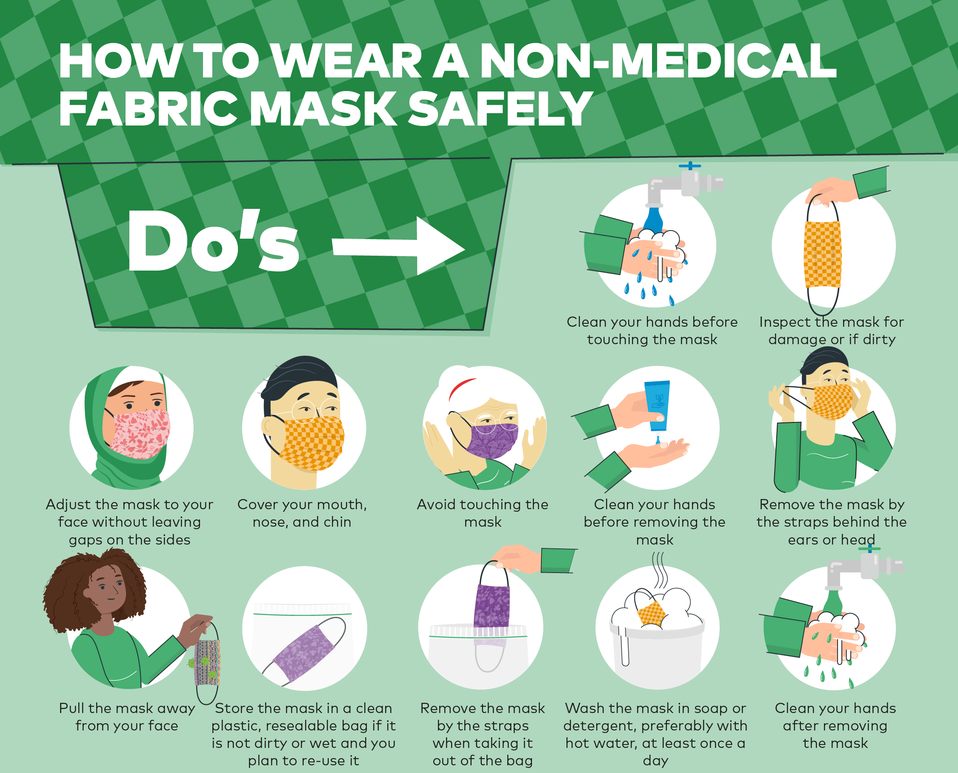
How to wear a cloth/fabric mask

Slide 20
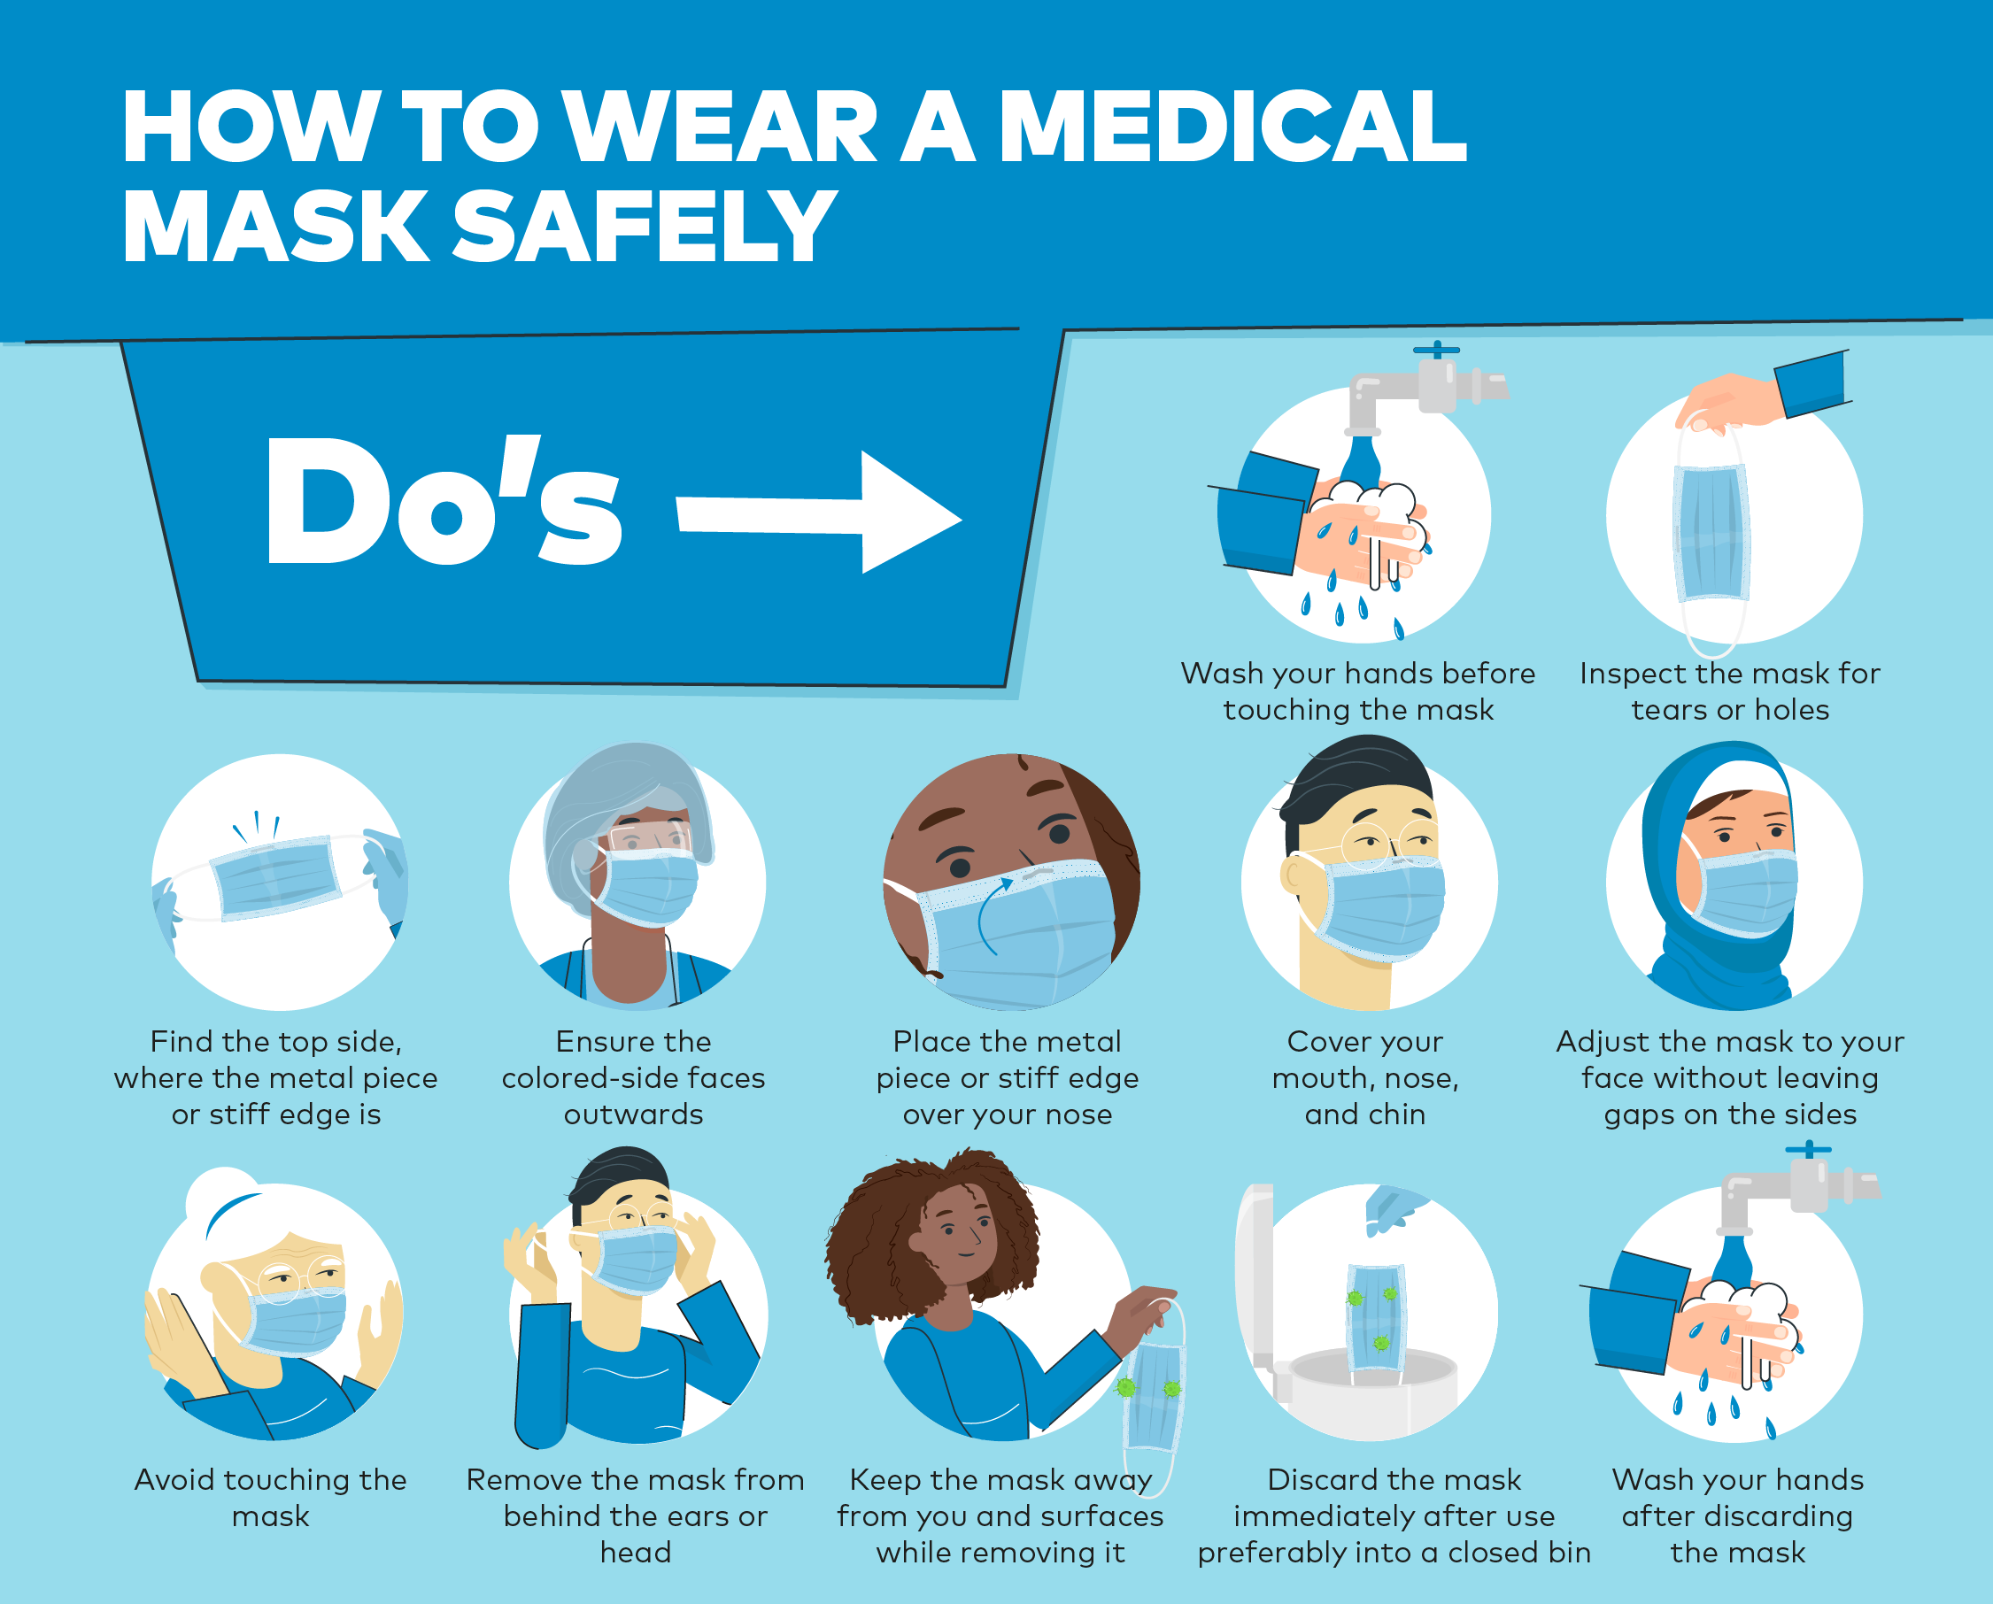
How to wear a medical mask

Slide 21
How to hand-wash
Wet hands with water
Apply enough soap to cover all hand surfaces
Rub hands palm to palm
Lather the back of your hands
Palm to palm with fingers interlaced
Rub the back of your opposing palms’ fingers

Slide 22
How to hand-wash (2)
Clean your thumbs repeatedly
Clean your fingernails and fingertips
Rinse your hands thoroughly
Dry them with a disposable hand towel
Use the towel to turn off the faucet
Your hands are now safe!

Slide 23
Let's practice!
Check and see—is your mask on correctly?
Let's walk through washing our hands according to the previous guidelines outlined!

Slide 24

Questions?

Slide 25
Test your understanding
How far of a distance should you maintain from others when practicing social distancing?
          0.25 meters
          0.50 meters
          1.00 meters
          2.00 meters
What does this look like? Are we all 2 meters apart?

Slide 26
Test your understanding (2)
Which of the following COVID-19 symptoms are VISIBLY apparent to others? (Select all that apply)
        Nasal Congestion
        Cough/Shortness of Breath
        Red Eyes
        Headache

Slide 27
Test your understanding (3)
What steps should you take if you are feeling ill or suspect that you have come into contact with a COVID-19 case? (Select all that apply)
Notify supervisor after completing all your work
Self-Isolate for at least 14 days
Seek medical attention if needed
Call national hotline for more information on reporting
IMMEDIATELY!

Slide 28
GENERAL MDA TEAM PRECAUTIONS

Slide 29
Composition of MDA team
Consider excluding persons at high-risk of COVID-19 (over 60 years, preexisting medical conditions) from field activities
Drug distributors who work in groups should remain with same group throughout duration of MDA
Additional personnel (volunteer/additional team member) should be designated focal point to ensure SoP (handwashing, PPE, social distancing) are being adhered to

Slide 30
Health of MDA team
All team members should be aware of the signs and symptoms of COVID-19
If anyone feels unwell at any time during MDA, they should inform their supervisor, stop work immediately, and seek medical care
Team members identified as having come into contact with COVID-19 in last 14 days should not work

Slide 31
Supervisor general responsibilities
If staff member tests positive for COVID-19, supervisor should report immediately to appropriate authorities
  Be aware of who will need to be informed if COVID-19 cases start to increase and who will make a decision for the team based on this information
Supervisor must maintain regular contact with field locations, understand cultural issues and political situations
Supervisor should reevaluate the expected number of households covered in a day during planning to take into account the additional time needed for COVID-mitigation measures
Supervisor should use checklist to make sure that all Standard Operating Procedures (SOPs) are being followed

Slide 32
General MDA protocols
Clean hands in between every household seen
Materials such as dosing poles should be washed or otherwise disinfected regularly
Avoid eating or drinking at homes visited
Dispense medicines outdoors
Wear masks at all times
Carry own hand sanitizer bottle

Slide 33
TRANSPORTATION

Slide 34
Getting to and from distribution sites
Screening
Hand-Washing
Persons experiencing COVID-19 symptoms or have come into contact with a COVID-19 case should NOT travel.
Driver and passengers must wash or sanitize hands before entering vehicle.
Ventilation
Masks
Vehicle windows should remain open if conditions permit.
Driver and passengers must wear masks at all times.

Slide 35
Screening for COVID-19 symptoms
Most Common Visible Symptoms suggestive of COVID-19:
Daily Temperature Check: Fever
Red Eyes
Nasal Congestion
Dry Cough
Shortness of Breath
World Health Organization, 2020. https://www.who.int/health-topics/coronavirus#tab=tab_3.

Slide 36
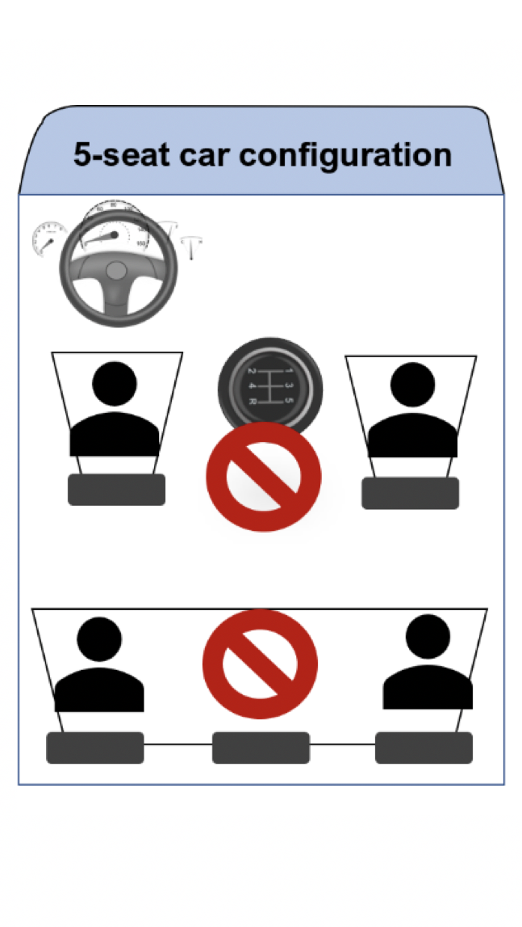
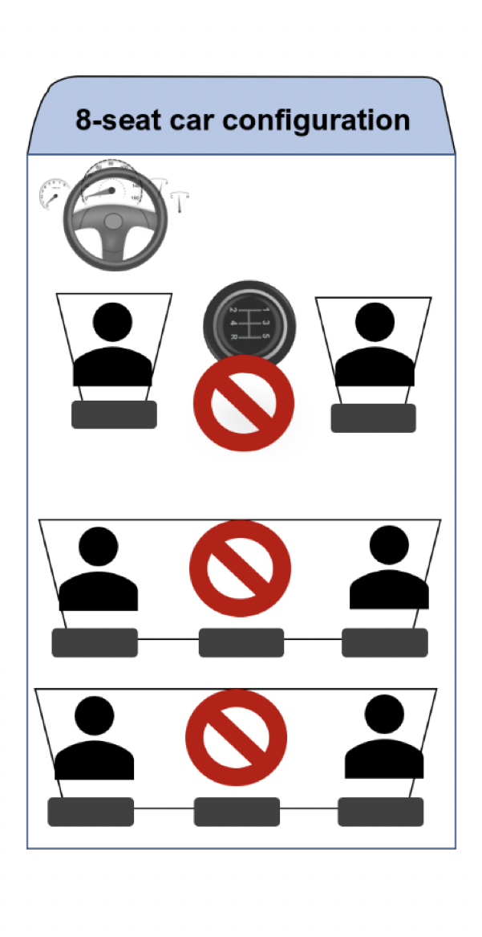
Spacing in cars when traveling
There should be at least one empty seat in between passengers
  5 seat cars: 3 passengers
  8 seat cats: 5 passengers
  12 seat minibuses: 7 passengers
  Buses: Seating arranged by supervisor and head of medical district/region

Slide 37
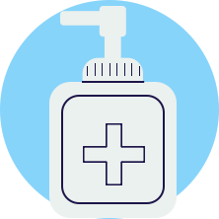
Arrival at destination
Before meeting with others, drivers and passengers must:
  Remove face mask if noticeably soiled, moist, or wet and replace with new face mask
  Wash or sanitize hands

Slide 38
HOUSEHOLD-BASED MDA

Slide 39
Standard protocol upon arrival
At 2-meter distance, introduce purpose of visit, provide basic COVID-19 info, & discuss where HH members should go if they have or develop COVID-19 symptoms
When possible, conduct distribution outside of each home to minimize risk of COVID-19 transmission

Slide 40
Standard protocol upon arrival (2)
Designate a member of MDA team to engage in crowd control & keep neighbors a safe distance away. Designated MDA team member should be wary of curious children crowding to observe treatment and should advise children to keep distance.
Set up so that all household members, including children, remain at least 2 meters away from MDA team

Slide 41
Treatment of adults and children able to swallow tablets
Call HH members one by one to avoid crowing
Request that everybody in household wash or sanitize hands
Height measurements taken with dose poles should be carried out with household member facing away from distributor and at a 2-m distance
    Wash or disinfect dose pole between households or if it has been touched accidentally
Try to maintain 2-m distance when dispensing medication
  Drug distributor should make effort to not touch tablets or bowl
Children can be assisted by an adult HH member. Should be advised to chew tablets if needed.
    A child should NEVER be forced to take the medicine
    A child's head and neck should NOT be held back nor should a child's nose be pinched

Slide 42
Treatment of children unable to swallow tablets
Drug distributor should call child by name and request mother or other adult familiar with child to support them as they stand against dose pole
  HH members should NOT touch dose pole
HH member can read out number on dose pole at top of child's head, or drug distributor can observe it from 2-m away
Distributor will measure out syrup and instruct mother (or other adult) on how this is administered and then step back 2-m away. Each child should have his/her own disposable syrup cup.
Mother (or other adult) steps forward and helps child drink syrup (without forcing child, to prevent choking which can result in death)
    A child should NEVER be forced to take the medicine
    A child's head and neck should NOT be held back nor should a child's nose be pinched
  Record as usual

Slide 43
Minimum additional materials
Masks
For MDA team and participants
Disinfectant
Alcohol/bleach solution use 70-90% ethanol/ethyl alcohol for equipment & sodium hypochlorite at 0.1%/1000 ppm for surfaces.
Water & Soap
Hand Sanitizer (60-80% Alcohol) is also acceptable.
Checklists
For COVID-19 symptoms
Notes:
Participants having to wear masks may be modified or deleted from slide depending on local guidance.

Slide 44
Minimum additional materials (2)
Chalk
To mark heights from dose pole
Clean Plate/Bowl
For children when applicable
Drinking Cups & Water
For taking medicines. Use disposable syrup cups for children when applicable

Slide 45
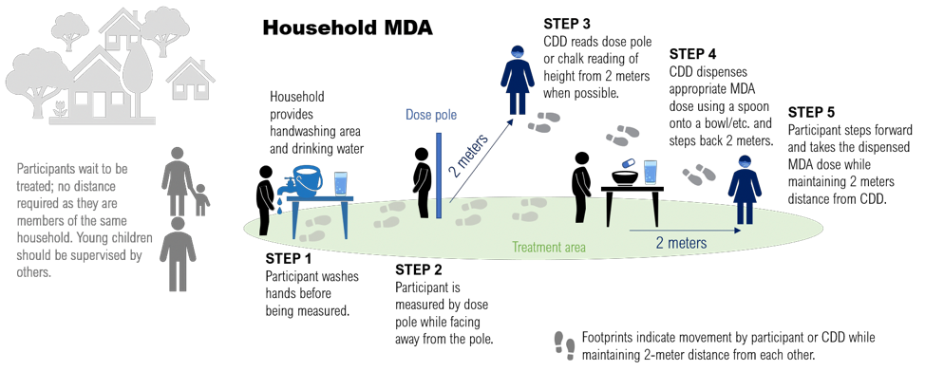
Conducting the distribution

Slide 46
Questions?

Slide 47
Test your understanding
Which of the following is NOT part of the standard protocol upon arrival?
      Ensure everyone is wearing a mask
      Handwashing
      Set up distribution indoors to mitigate spread of virus
      Monitor younger children
outdoors

Slide 48
Test your understanding
Name one way this set-up differs from a regular MDA pre-COVID.
MDA team and participants must wear masks at all times
All participants must wash hands prior to distribution
Height measurements should be taken with household member facing away from distributor and at a 2-m distance
Distribution should be conducted outdoors
Upon arrival, inquire whether any HH member has or has had COVID-19 symptoms
Notes:
Participants having to wear masks may be modified or deleted from slide depending on local guidance.

Slide 49
Discussion
What do you think will be the most difficult COVID-19 measure to implement?
MDA team and participants must wear masks at all times
All participants must wash hands prior to distribution
Height measurements should be taken with household member facing away from distributor and at a 2-m distance
Distribution should be conducted outdoors
Upon arrival, inquire whether any HH member has or has had COVID-19 symptoms
Notes:
Participants having to wear masks may be modified or deleted from slide depending on local guidance.

Slide 50
Discussion (2)
How will you deal with groups of curious children who want to gather to see what is going on?
TWO METERS

Slide 51

Let's practice!
As a group, let's role-play this MDA set up in the context of COVID-19!

Slide 52
STATIC POINT / COMMUNITY MDA

Slide 53
Standard protocol before day of distribution
Due to the greater risk of infection of Static-Point MDAs, the feasibility of Household MDAs should be considered first
Evaluate distribution point to ensure it allows for good ventilation (preferably outdoors) and has enough space for social distancing.
  Eg., outdoor market, park, school yard
Post signs at entrance providing general info on COVID-19 and what to expect during drug distribution
Set up Waiting Area, Handwashing, and Height Measurement/Treatment Stations
Assign team members to roles of either managing a station or engaging in crowd control

Slide 54
Minimum additional materials
Masks
For MDA team and participants
Disinfectant
Alcohol/bleach solution use 70-90% ethanol/ethyl alcohol for equipment & sodium hypochlorite at 0.1%/1000 ppm for surfaces.
Water & Soap
Hand Sanitizer (60-80% Alcohol) is also acceptable.
Checklists
For COVID-19 symptoms
Notes:
Participants having to wear masks may be modified or deleted from slide depending on local guidance.

Slide 55

Minimum additional materials (2)
Dose Poles
Can also be used to measure distances
Chalk
To mark heights from dose pole
Station Signs
For each MDA station
Drinking Cups & Water
For taking medicines. Use disposable syrup cups for children when applicable

Slide 56


Minimum additional materials (3)
Dust Bins
For collecting waste
Small & Clean Pieces of Paper
On which to lay medicines
Spoons
To distribute medicines

Slide 57
Standard protocol on the day of distribution
Megaphones should be used to explain the COVID-19 precautionary measures being taken
All team members and participants must wear masks
Family groups can stay together
Station managers should ensure that max number of people allowed at each station is adhered to and distance between family groups is maintained
Station managers should be wary of curious children crowding to observe treatment and should advise children to keep distance
If overcrowding occurs, station managers may ask individuals to come back at a later time
Notes:
Participants having to wear masks may be modified or deleted from slide depending on local guidance.

Slide 58
Stations set up
Waiting Area
Handwashing
Height Measurement & Treatment
Use chalk to set up markings on ground that designate spaces 2 meters apart in waiting area.
Ensure everyone washes hands with soap and water for at least 20 seconds or uses hand sanitizer (60-80% alcohol).
Instruct each person to stand with back to pole and record number of tablets from distance of 2m. Dose poles should be placed so that they do not need to be held or touched.
Try to maintain 2m distance when dispensing medication. Wash or sanitize hands between every household group seen.

Slide 59
Treatment Protocol: Adults
For Adults:
  Distributor should lay out a clean piece of paper on table that stands between them and HH member
  Once dosage is known, distributor steps forward and drops tablets on paper
  Distributor should make effort to NOT touch the tablets
  Paper should be changed between each HH group

Slide 60
Treatment Protocol: Children
For Children:
  Distributor should measure out syrup / tablets and instruct mother or adult HH member how to administer and then step back 2m
  Child should be advised to chew tablets
  Mother or adult HH member can assist child with taking medicine
  Assisting adults should NEVER FORCE a child to take the medicine and should NOT hold the child's head and neck back nor pinch the child's nose​
    These can cause choking which can result in death

Slide 61
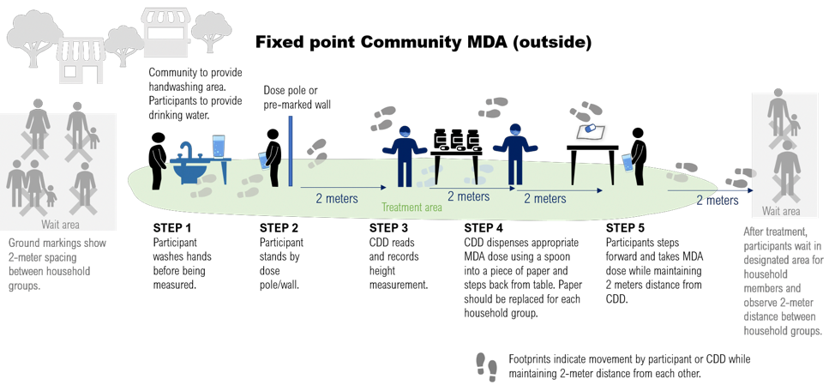
Conducting the distribution

Slide 62
Questions?

Slide 63
Test your understanding
True or False: Family groups cannot stay together during community MDA.
          True
          False

Slide 64
Test your understanding
Name one way this set-up differs from a regular MDA pre-COVID.
MDA team and participants must wear masks at all times
Participants should stay at least 2 meters away from each other in waiting area
All participants must wash or sanitize hands prior to distribution
Megaphones used to explain COVID-19 precautionary measures being taken
Distribution should preferably be conducted outdoors
Height measurements should be taken with household member facing away from distributor and at a 2-m distance
Notes:
Participants having to wear masks may be modified or deleted from slide depending on local guidance.

Slide 65
Discussion
What do you think will be the most difficult COVID-19 measure to implement?
MDA team and participants must wear masks at all times
Participants should stay at least 2 meters away from each other in waiting area
All participants must wash or sanitize hands prior to distribution
Megaphones used to explain COVID-19 precautionary measures being taken
Distribution should preferably be conducted outdoors
Height measurements should be taken with household member facing away from distributor and at a 2-m distance
Notes:
Participants having to wear masks may be modified or deleted from slide depending on local guidance.

Slide 66
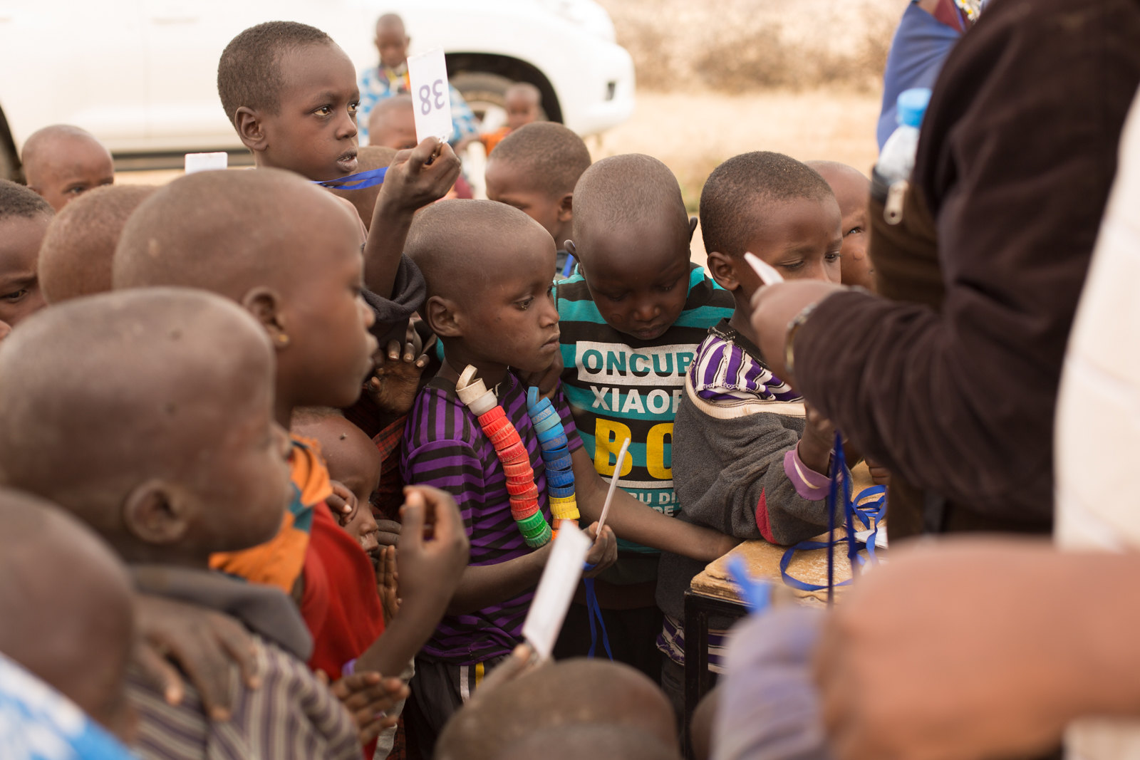
Discussion (2)
How will you deal with groups of curious children who want to gather to see what is going on?

Slide 67
Let's practice!
As a group, let's role-play this MDA set up in the context of COVID-19!

Slide 68
SCHOOL-BASED MDA

Slide 69
Standard protocol upon arrival
Drug distribution for each class must be handled separately
Teacher should introduce activity and explain the COVID-19 precautionary measures that should be taken
Medicine should be administered by teacher or medical personnel approved by school. At least one other adult from within school should be present.
Dosage heights can be marked on a classroom wall with chalk using a dose pole as a guide
Generally, if school has more strict regulations and requirements, defer to the school's guidelines (e.g., mask wearing, distance from sampling, etc.)
Notes:
Participants having to wear masks may be modified or deleted from slide depending on local guidance.

Slide 70
Stations set up
Waiting Area (OPTIONAL)
Height Measurement
Handwashing
Handwashing
Treatment
Each child should be called one-by-one to avoid crowding at measurement and medicine tables
Ensure everyone washes hands with soap and water for at least 20 seconds or uses hand sanitizer (60-80% alcohol)
Instruct each child to stand with back to pre-drawn chalk marks. Record number of tablets from distance of 2m
Try to maintain 2m distance when dispensing medication.

Slide 71
Treatment Protocol: Students
Student can place a clean bowl/plate/ paper on a table or chair between themselves and the teacher and then step back 2 meters
Teacher can then step forward, drop the tablets in the bowl/plate/paper, and then step back to allow the student to step forward and take the pills
Effort should be made by the teacher not to touch the tablets or bowl
Each child should be encouraged to bring their own container/cup for drinking water provided by the school or brought from home. Disposable cups as back up may be necessary
TWO METERS

Slide 72
Minimum additional materials
Masks
For MDA team and participants
Disinfectant
Alcohol/bleach solution use 70-90% ethanol/ethyl alcohol for equipment & sodium hypochlorite at 0.1%/1000 ppm for surfaces.
Water & Soap
Hand Sanitizer (60-80% Alcohol) is also acceptable.
Checklists
For COVID-19 symptoms
Notes:
Participants having to wear masks may be modified or deleted from slide depending on local guidance.

Slide 73
Minimum additional materials (2)
Dose Poles
Can also be used to measure distances
Chalk
To mark heights from dose pole
Clean Plate/Bowl
For children when applicable
Drinking Cups & Water
For taking medicines. Use disposable syrup cups for children when applicable

Slide 74
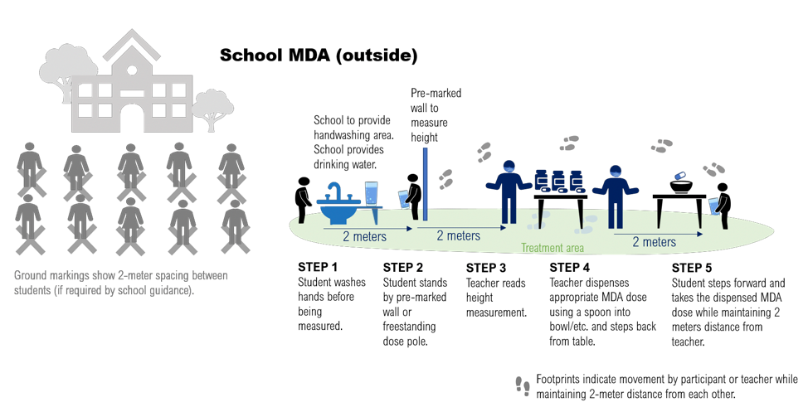
Conducting the distribution

Slide 75
Questions?

Slide 76
Test your understanding
True or False: Teachers or designated school personnel should administer medicine.
          True
          False

Slide 77
Test your understanding
Name one way this set-up differs from a regular MDA pre-COVID.
MDA team and participants must wear masks at all times
Participants should stay at least 2 meters away from each other in waiting area and during treatment
All participants must wash hands before treatment
Work closely with teachers and school staff to coordinate COVID-19 precautionary measures
Distribution should preferably be conducted outdoors
Perform height measurements at a distance
Notes:
Participants having to wear masks may be modified or deleted from slide depending on local guidance.

Slide 78
Discussion
What do you think will be the most difficult COVID-19 measure to implement?
MDA team and participants must wear masks at all times
Participants should stay at least 2 meters away from each other in waiting area and during treatment
All participants must wash hands before treatment
Work closely with teachers and school staff to coordinate COVID-19 precautionary measures
Distribution should preferably be conducted outdoors
Perform height measurements at a distance
Notes:
Participants having to wear masks may be modified or deleted from slide depending on local guidance.

Slide 79
Discussion (2)
How will you deal with groups of curious children who want to gather to see what is going on?
TWO METERS

Slide 80
Let's practice!
As a group, let's role-play this MDA set up in the context of COVID-19!

Slide 81
MDA SUPERVISION

Slide 82
Supervision in the context of COVID-19
Supervisors should follow the same infection control measures as drug distributors
In-person supervision should ideally be delegated to local supervisors as much as possible
Supervisors should:
  Follow and implement the infection control measures outlined in the General MDA Team Precautions slides
  Provide immediate feedback to drug distributors if observe anything not in line with COVID-19 protocol
  Summarize any issues being addressed in regular feedback to own supervisors
  Highlight any priority concerns for district- and central-level staff

Slide 83
Pre-training: supervision checklist
Is the venue large enough to accommodate the intended number of participants with 2m between?
Are seats, benches, desks arranged 2m apart?
Is the venue well-ventilated? Are windows and doors functioning well and are open?
Is the venue marked to limit access of unauthorized personnel?
Is the venue cleaned and disinfected with standard cleaning and disinfectants before participants arrive?
Is shared bathroom cleaned and disinfected with standard cleaning and disinfectants before participants arrive?
Is there a washing area set up and equipped with adequate supply of water and soap at the beginning of the training?

Slide 84
Pre-training: supervision checklist (2)
Is there a focal person assigned to monitor all hygiene and sanitation supplies and activities during the event?
Is adequate alcohol-based sanitizer available in areas where water is scarce?
Is there an area designated for COVID-19 screening upon arrival?
  Fever
  Visibly apparent symptoms such as cough, shortness of breath, nasal congestion & red eyes
Is there a focal point assigned to manage screening? Do they have a COVID-19 signs and symptoms checklist available to them?
Is every attendee wearing a face mask? Is the mask worn properly (covering nose and chin)?

Slide 85
Post-training: supervision checklist
Is the venue cleaned and disinfected with standard cleaning and disinfectants at the end of the day?
Is shared bathroom cleaned and disinfected at the beginning and end of the day?
Were all materials and equipment disinfected after each use?
Did participants wash their hands with soap or use hand sanitizer properly as they went out and returned to the venue for any reason?

Slide 86
Post-training: supervision checklist (2)
Was every participant screened for signs and symptoms of COVID-19 using a checklist and thermometer before entering the venue?
If a participant reported COVID-19 symptoms, were they managed following local guidelines?
Were disposable masks properly disposed of in the waste bin after the training?

Slide 87
MDA: supervision checklist
All community drug distributors (CDDs) had received training on COVID-19 prevention measures
CDDs were screened for illness and no sick person as allowed to work
Treatment was done outside
CDDs and participants always wore face masks
Two meters distance was maintained between participants and CDDs at all times
CDDs washed hands thoroughly on entry and leaving
Appropriate communication was given to participants including information on COVID-19 safety precautionary measures and how those would be applied during distribution
A clean and dry plate or bowl was used for handling tablets
CDD did not touch tablets with their hands
At household surveys, CDDs were all of the same family or kinship group
At school-based surveys, all school regulations and requirements were adhered to
At static-point surveys, overcrowding was avoided, family groups waited in line together, and interactions between community members were minimized
Notes:
Participants having to wear masks may be modified or deleted from slide depending on local guidance.

Slide 88
Questions?

Slide 89



ACKNOWLEDGMENTS
This presentation is made possible by the generous support of the American People through the United States Agency for International Development (USAID). The contents are the responsibility of Act to End NTDs | East, led by RTI International in partnership with The Carter Center, Fred Hollows Foundation, IMA World Health, Light for the World, Sightsavers, Results for Development, Save the Children, and WI-HER under cooperative agreement No. 7200AA18CA00040 and do not necessarily reflect the views of USAID or the United States Government.

