Slide 1
Transmission Assessment Survey (TAS) COVID-19 Training Module
Presenter Name
Event, Location
Date
World Health Organization, 27 July 2020.https://www.who.int/publications/i/item/WHO-2019-nCoV-neglected-tropical-diseases-2020-1

Slide 2
About this resource
This is a generic module based on the Practical Approaches to Implementing WHO Guidance for Neglected Tropical Disease (NTD) Programs in the Context of COVID-19: Lymphatic filariasis (LF) survey.
It is intended to be adapted to local context and situations.

Slide 3
TRAINING
Notes:
Some of these slides could be used in the main training (e.g. norms), while others might not make sense for the main training.
Some of the slides might be useful to present in the main training if the trainees will be responsible for cascading the training to lower levels.

Slide 4
Norms during in-person trainings
Screening
Hand-Washing
Safety
Persons experiencing COVID-19 symptoms or have come into contact with a COVID-19 case should NOT participate.
All trainees should wash hands upon arrival and whenever appropriate during training ie. touching a contaminated surface.
Eating and drinking during training should be avoided. Equipment and surfaces should be disinfected at least twice daily.
Masks
Social Distancing
Masks should be worn at all times by both trainers and trainees.
All participants should maintain at least a 2 meters distance from others.

Slide 5
Virtual trainings
Preferred method of training is Virtual:
Live Web-Based Training if internet available
Recorded trainings and FAQ that can be distributed via CD, USB, or mobile application
Since Virtual Trainings have not been the norm, experimentation is necessary to find the best methods that work for survey team
Notes:
Use for higher-level trainings

Slide 6
In-person training guidelines
If in-person trainings must take place, then the following guidelines should be observed:
Head trainer or supervisor should screen all trainees for COVID-19 signs and symptoms upon arrival. Anyone with symptoms or at high-risk should not participate.
Avoid delays between training and field implementation
Trainings should preferably be conducted outdoors, otherwise ensure good ventilation e.g. with open windows
Wash stations should be available at every training
Before commencing training, have ready all materials needed for survey (drugs, diagnostic tests, Job Aides), cloth masks, and personal protective equipment (PPE)
Notes:
Use for higher-level trainings

Slide 7
Additional equipment list for in-person trainings
Masks for all participants and trainers
Disinfectant for wiping surfaces (use 70-90% ethanol/ethyl alcohol for equipment and sodium hypochlorite at 0.1%/1000ppm for surfaces)
Handwashing Water/Soap or Hand Sanitizer
Disposable Paper Towels
Dust Bin
COVID-19 signs and symptoms checklist for screening of all participants
Gloves
Lab Coats/Gowns
Notes:
Use for higher-level trainings

Slide 8
COVID-19 GENERAL INFORMATION

Slide 9
What is COVID-19?
COVID-19 Virus
COVID-19 is the infectious disease caused by the most recently discovered coronavirus
This new virus and disease were unknown prior to the start of the outbreak in December 2019
World Health Organization, 17 April 2020. https://www.who.int/emergencies/diseases/novel-coronavirus-2019/question-and-answers-hub/q-a-detail/q-a-coronaviruses

Slide 10
Is there a vaccine, drug, or treatment for COVID-19?
While some Western, traditional, or home remedies may provide comfort and alleviate symptoms of mild COVID-19, there are no medicines that have been shown to prevent or cure the disease
There is no vaccine available yet for COVID-19
World Health Organization, 17 April 2020. https://www.who.int/emergencies/diseases/novel-coronavirus-2019/question-and-answers-hub/q-a-detail/q-a-coronaviruses

Slide 11
Screening for COVID-19 symptoms
Most Common Visible Symptoms suggestive of COVID-19:
Red Eyes
Fever
Dry Cough
Nasal Congestion
Shortness of Breath
World Health Organization, 2020. https://www.who.int/health-topics/coronavirus#tab=tab_3.

Slide 12
How serious is COVID-19?
Most people (about 80%) recover from the disease without needing hospital treatment.
Around 1 out of every 5 people who gets COVID-19 becomes seriously ill and can develop serious symptoms such as:
Difficulty breathing or shortness of breath
Chest pain or pressure
New confusion or loss of speech and movement
Death
World Health Organization, 8 March 2020. https://www.who.int/indonesia/news/detail/08-03-2020-knowing-the-risk-for-covid-19

Slide 13
High-risk groups
Older individuals typically over 60 years old
COVID-19 can be still be a serious illness for all age-groups
Those with underlying medical problems such as:
High Blood Pressure
Heart and Lung Problems
Diabetes
Cancer
World Health Organization, 2020. https://www.who.int/westernpacific/emergencies/covid-19/information/high-risk-groups

Slide 14
How does COVID-19 spread?
Primarily from Person-to-Person through small droplets from the nose to mouth
Expelled when a person with COVID-19 speaks, coughs, or sneezes
Most people get sick about 5 days after exposure
Although COVID-19 can live in the body for a period of 2 to 14 days before signs of illness appear
Some people, especially children, can be infected and not show any signs of illness
World Health Organization, 17 April 2020. https://www.who.int/emergencies/diseases/novel-coronavirus-2019/question-and-answers-hub/q-a-detail/q-a-coronaviruses

Slide 15
How long does COVID-19 survive on surfaces?
Studies have shown that the COVID-19 virus can survive for up to 72 hours on plastic and stainless steel, less than 4 hours on copper and less than 24 hours on cardboard.
However, recent studies have shown that transmission from surfaces is limited.
Surfaces and equipment can easily be cleaned with sodium hypochlorite at 0.1%/1000 ppm and 70-90% alcohol, respectively.
It’s important to always disinfect materials used during pre-TAS or TAS!
World Health Organization, 17 April 2020. https://www.who.int/emergencies/diseases/novel-coronavirus-2019/question-and-answers-hub/q-a-detail/q-a-coronaviruses
World Health Organization, 27 July 2020. https://www.who.int/publications/i/item/WHO-2019-nCoV-neglected-tropical-diseases-2020-1

Slide 16
Suspect cases
It is important to self-isolate for at least 14 days if:
You are feeling ill and meet the case definition previously mentioned
You think you have come into contact with a COVID-19 patient
You have travelled to an area with high community transmission
Along with self-isolation, please do the following:
Inform pre-TAS or TAS supervisor or designated point person
Seek medical attention by contacting local health facility through phone if possible
Use national hotline if need more information on reporting

Slide 17
What can I do to protect myself and others?
Regularly and thoroughly clean hands with alcohol-based hand rub or soap & water
Maintain at least 2 meters distance between yourself and others
Avoid going to crowded places
Avoid touching eyes, nose, and mouth
Wear a medical mask if available
Make sure you and the people around you follow good respiratory hygiene
World Health Organization, 17 April 2020. https://www.who.int/emergencies/diseases/novel-coronavirus-2019/question-and-answers-hub/q-a-detail/q-a-coronaviruses

Slide 18
Wearing a disposable mask
Wash your hands or use alcohol-based sanitizer before putting on and after taking off mask
Inspect mask for tears or holes
Cover your nose, mouth and chin with mask
Discard mask in closed bin immediately

Slide 19
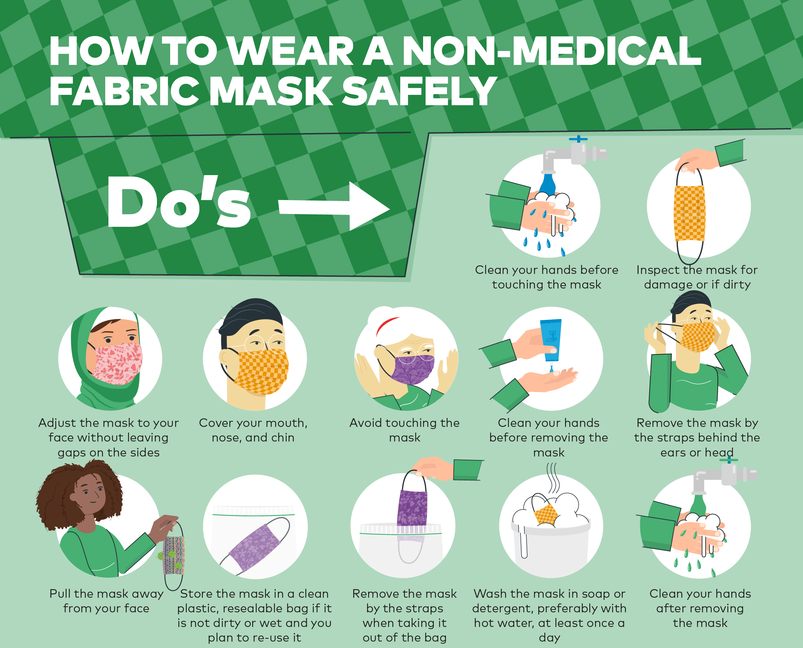
How to wear a cloth/fabric mask

Slide 20
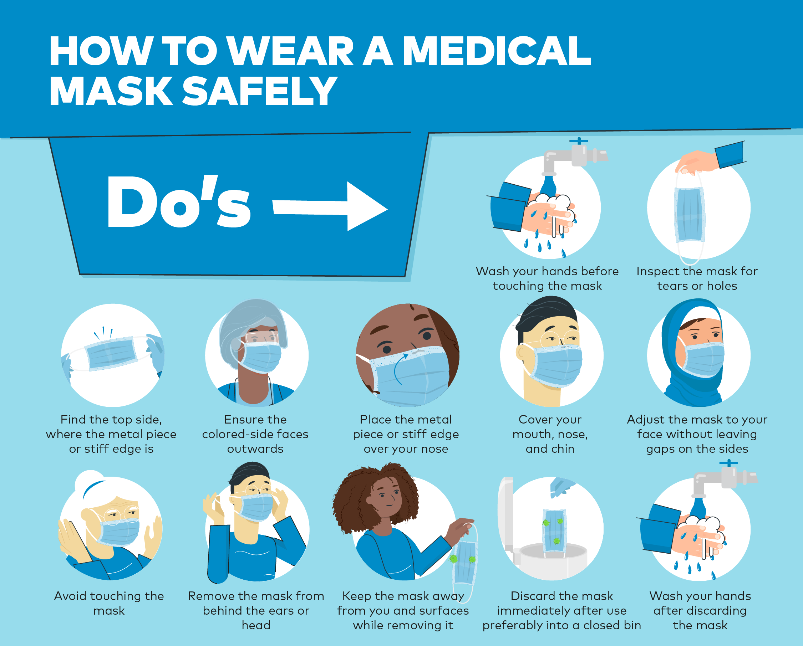
How to wear a medical mask

Slide 21
How to hand-wash
Wet hands with water
Apply enough soap to cover all hand surfaces
Rub hands palm to palm
Lather the back of your hands
Palm to palm with fingers interlaced
Rub the back of your opposing palms’ fingers

Slide 22
How to hand-wash (2)
Clean your thumbs repeatedly
Clean your fingernails and fingertips
Rinse your hands thoroughly
Dry them with a disposable hand towel
Use the towel to turn off the faucet
Your hands are now safe!

Slide 23
Let's practice!
Check and see—is your mask on correctly?
Let's walk through washing our hands according to the previous guidelines outlined!

Slide 24
Questions?

Slide 25
Test your understanding
How far of a distance should you maintain from others when practicing social distancing?
0.25 meters
0.50 meters
1.00 meters
2.00 meters
What does this look like? Are we all 2 meters apart?

Slide 26
Test your understanding (2)
Which of the following COVID-19 symptoms are VISIBLY apparent to others? (Select all that apply)
Nasal Congestion
Cough/Shortness of Breath
Red Eyes
Headache

Slide 27
Test your understanding (3)
What steps should you take if you are feeling ill or suspect that you have come into contact with a COVID-19 case? (Select all that apply)
Notify survey supervisor after completing all your work
Self-Isolate for at least 14 days
Seek medical attention if needed
Call national hotline for more information on reporting
IMMEDIATELY!

Slide 28
GENERAL SURVEY TEAM PRECAUTIONS

Slide 29
Composition of survey team
Consider excluding persons at high-risk of COVID-19 (over 60 years, preexisting medical conditions) from field activities
Survey team must always be with a representative from health district or health facility
Survey team should remain with same groups throughout duration of survey
Additional personnel (volunteer/additional team member) should be designated focal point to ensure SoP (handwashing, PPE, social distancing) are being adhered to

Slide 30
Health of survey team
All survey team members should be aware of the signs and symptoms of COVID-19
If anyone feels unwell at any time during survey, they should inform their supervisor, stop work immediately, and seek medical care
Team members identified as having come into contact with COVID-19 in last 14 days should not work

Slide 31
Supervisor general responsibilities
If staff member tests positive for COVID-19, supervisor should report immediately to appropriate authorities
Be aware of who will need to be informed if COVID-19 cases start to increase and who will make a decision for the team based on this information
Supervisor must maintain regular contact with field locations, understand cultural issues and political situations
Supervisor should reevaluate the expected number of persons to be tested in a day during planning to take into account the additional time needed for COVID-mitigation measures
Supervisor should use checklist to make sure that all Standard Operating Procedures (SOPs) are being followed

Slide 32
General survey protocols
Regularly and thoroughly clean hands with alcohol-based hand rub or soap & water
All equipment and surfaces should be disinfected as often as possible
Avoid eating or drinking during survey
Conduct survey preferably outdoors
Wear masks at all times
Use same smartphones throughout survey

Slide 33
Minimum additional materials
Masks
For participants and survey team
Disinfectant
Alcohol/bleach solution use 70-90% ethanol/ethyl alcohol for equipment & sodium hypochlorite at 0.1%/1000 ppm for surfaces.
Water & Soap
Hand Sanitizer (70-90% Alcohol) is also acceptable.
Gloves
For Surveyors
Notes:
Participants having to wear masks may be modified or deleted from slide depending on local guidance.

Slide 34
Minimum additional materials (2)
3-Meter Stick
For measuring social distance
Chalk/Tape
To mark where person waiting should stand
Checklists
For COVID-19 symptoms
Pens
Should not be shared

Slide 35
Minimum additional materials (3)
Plastic
Bags
For collecting waste
Foldable Chairs
When possible
Foldable Tables
When possible

Slide 36
TRANSPORTATION

Slide 37
Getting to and from survey sites
Screening
Hand-Washing
Persons experiencing COVID-19 symptoms or have come into contact with a COVID-19 case should NOT travel.
Driver and passengers must wash or sanitize hands before entering vehicle.
Ventilation
Masks
Vehicle windows should remain open if conditions permit.
Driver and passengers must wear masks at all times.

Slide 38
Screening for COVID-19 symptoms
Most Common Visible Symptoms suggestive of COVID-19:
Daily Temperature Check: Fever
Red Eyes
Nasal Congestion
Dry Cough
Shortness of Breath
World Health Organization, 2020. https://www.who.int/health-topics/coronavirus#tab=tab_3.

Slide 39
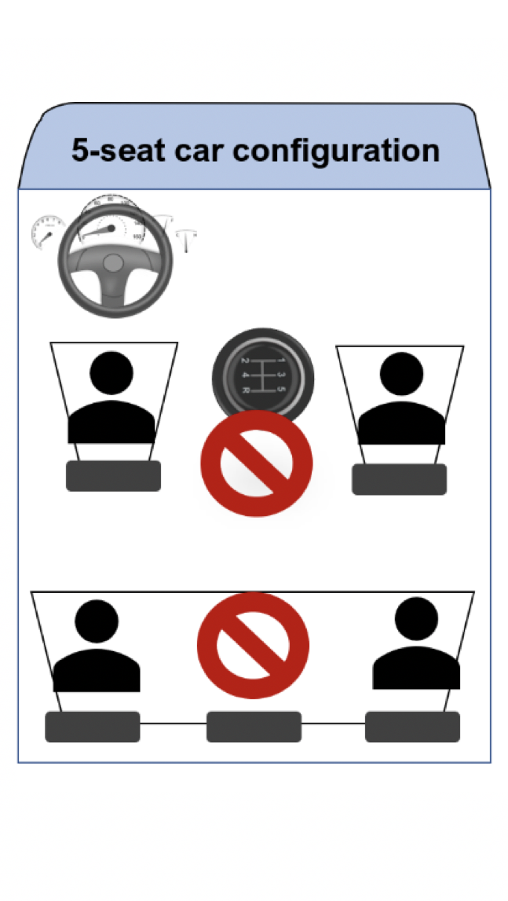
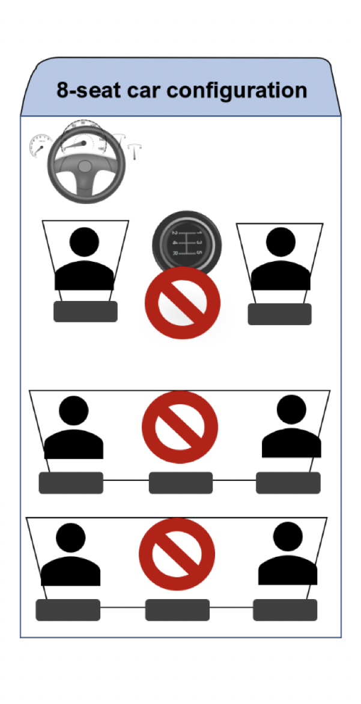
Spacing in cars when traveling
There should be at least one empty seat in between passengers
5 seat cars: 3 passengers
8 seat cats: 5 passengers
12 seat minibuses: 7 passengers
Buses: Seating arranged by survey supervisor and head of medical district/region

Slide 40
Arrival at destination
Before meeting with others, drivers and passengers must:
Remove face mask if noticeably soiled, moist, or wet and replace with new face mask
Wash or sanitize hands

Slide 41
HOUSEHOLD LF SURVEY

Slide 42
Standard protocol upon arrival
Introduce LF survey, provide basic COVID-19 info, & discuss where HH members should go if they have or develop COVID-19 symptoms
Set up survey outdoors to minimize risk of COVID-19 transmission

Slide 43
Standard protocol upon arrival (2)
Set up so that all household members, including children, remain at least 2 meters away from survey team
Designate a member of survey team to engage in crowd control & keep neighbors a safe distance away

Slide 44
Standard protocol upon arrival (3)
Emphasize need for everyone to wash or sanitize hands for at least 20 seconds
Make sure that everyone is wearing a mask correctly
Notes:
Participants having to wear masks may be modified or deleted from slide depending on local guidance.

Slide 45
Prior to conducting the examination
Table used to conduct FTS should be disinfected
Consent Form should be laminated to allow sanitizing between participants
Everyone should sanitize hands before and after touching pen or consent form
Notes:
Second bullet should only be included if written consent forms are used

Slide 46
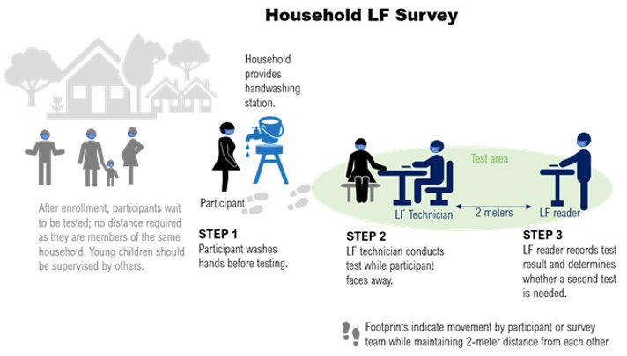
Conducting the examination
*Figure shows community participants WITH MASKS: Choose appropriate figure (present slide or next slide) based on local guidance.

Slide 47
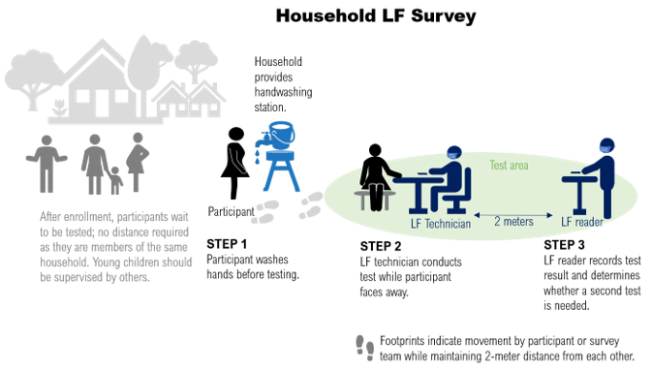
Conducting the examination (2)
*Figure shows community participants WITHOUT MASKS: CHOOSE appropriate figure (present slide or previous slide) based on local guidance.

Slide 48
Questions?

Slide 49
Test your understanding
Which of the following is NOT part of the standard protocol upon arrival?
Ensure everyone is wearing a mask
Handwashing
Ideally, set up survey indoors to mitigate spread of virus
Monitor younger children
outdoors
Notes:
Participants having to wear masks may be modified or deleted from slide depending on local guidance.

Slide 50
Test your understanding
DISCUSSION: Name one way this set-up differs from a regular survey pre-COVID.
Survey team and participants must wear masks at all times
All participants must wash hands before testing
Participants should face away from blood drawer during testing
Surveys should preferably be conducted outdoors
Upon arrival, inquire whether any HH member has or has had COVID-19 symptoms
Notes:
Participants having to wear masks may be modified or deleted from slide depending on local guidance.

Slide 51
Discussion
What do you think will be the most difficult COVID-19 measure to implement?
Survey team and participants must wear masks at all times
All participants must wash hands before testing
Participants should face away from blood drawer during testing
Surveys should preferably be conducted outdoors
Upon arrival, inquire whether any HH member has or has had COVID-19 symptoms
Notes:
Participants having to wear masks may be modified or deleted from slide depending on local guidance.

Slide 52
Discussion (2)
How will you deal with groups of curious children who want to gather to see what is going on?
TWO METERS

Slide 53
Let's practice!
As a group, let's role-play this survey set up in the context of COVID-19!

Slide 54
STATIC POINT LF SURVEY

Slide 55
Standard protocol before day of survey
Coordinate with local organizers & volunteers
Evaluate survey location to ensure it allows for good ventilation (preferably outdoors) and has enough space for social distancing
Post signs at entrance providing general info on COVID-19
Set up Waiting Area, Welcome Table, Handwashing, Testing, and Recording Stations
Assign team members to roles of either managing a station or engaging in crowd control
Consent Form should be laminated to allow sanitizing between participants
Set up a plan for disposal of waste

Slide 56
Stations set up
Waiting Area
Welcome Table
Handwashing
Testing
Recording
Use chalk to set up markings on ground that designate spaces 2 meters apart in waiting area.
Register participants. Ensure everyone is sanitizing hands before and after touching pen or consent form.
Ensure everyone washes hands with soap and water for at least 20 seconds.
Wipe arm rest surface with sanitizing solution/towel between participants & change gloves between every participant.
Maintain social distancing and ensure confidentiality when reading results.

Slide 57
Standard protocol on the day of survey
Megaphones should be used to explain the COVID-19 precautionary measures being taken
All survey team members and participants must wear masks
Family groups can stay together
Station managers should ensure that max number of people allowed at each station is adhered to and distance between family groups is maintained
Notes:
Participants having to wear masks may be modified or deleted from slide depending on local guidance.

Slide 58
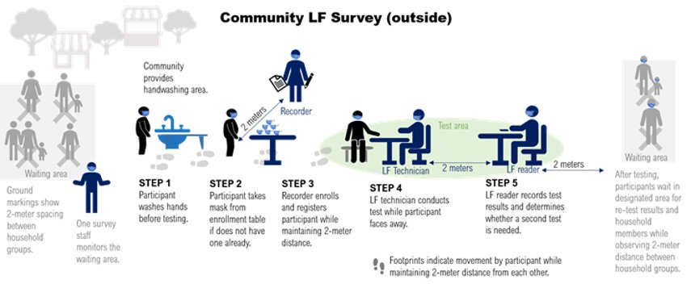
Conducting the examination
*Figure shows community participants WITH MASKS: Choose appropriate figure (present slide or next slide) based on local guidance.

Slide 59
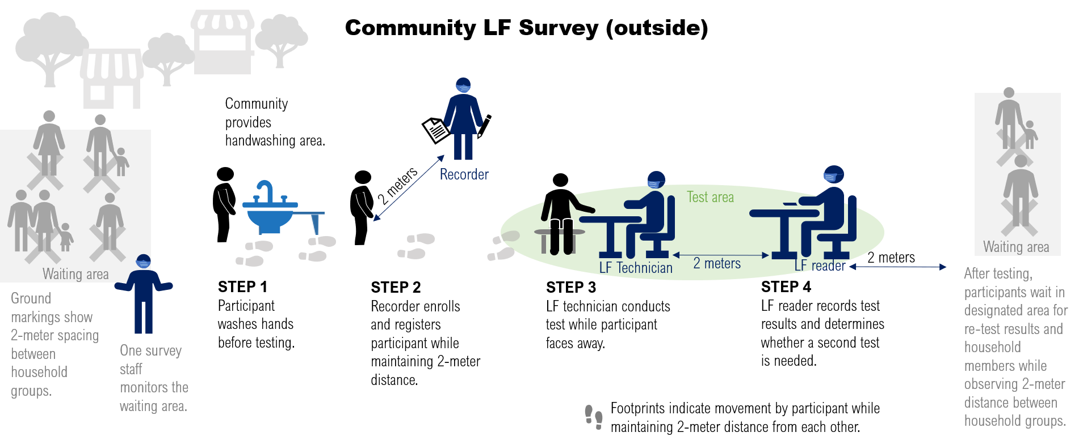
Conducting the examination (2)
*Figure shows community participants WITHOUT MASKS: Choose appropriate figure (present slide or previous slide) based on local guidance.

Slide 60
Questions?

Slide 61
Test your understanding
True or False: Family groups cannot stay together during static point LF survey.
True
False

Slide 62
Test your understanding
DISCUSSION: Name one way this set-up differs from a regular survey pre-COVID.
Survey team and participants must wear masks at all times
Participants should stay at least 2 meters away from each other in waiting area
All participants must wash hands before testing
Megaphones used to explain COVID-19 precautionary measures being taken
Surveys should preferably be conducted outdoors
Participants should face away from blood drawer during testing
Notes:
Participants having to wear masks may be modified or deleted from slide depending on local guidance.

Slide 63
Discussion
What do you think will be the most difficult COVID-19 measure to implement?
Survey team and participants must wear masks at all times
Participants should stay at least 2 meters away from each other in waiting area
All participants must wash hands before testing
Megaphones used to explain COVID-19 precautionary measures being taken
Surveys should preferably be conducted outdoors
Participants should face away from blood drawer during testing
Notes:
Participants having to wear masks may be modified or deleted from slide depending on local guidance.

Slide 64
Discussion (2)
How will you deal with groups of curious children who want to gather to see what is going on?
TWO METERS

Slide 65
Let's practice!
As a group, let's role-play this survey set up in the context of COVID-19!

Slide 66
SCHOOL-BASED LF SURVEY

Slide 67
Standard protocol upon arrival
Coordinate with school & health post staff to set up COVID-19 precautionary measures
Evaluate survey location to ensure it allows for good ventilation (preferably outdoors) and has enough space for social distancing between school staff/students and the external survey team
Ensure that all survey team members and participants are wearing masks
Set up Waiting Area, Registration, Handwashing, Testing, and Recording Stations
Set up a plan for disposal of waste
Notes:
Participants having to wear masks may be modified or deleted from slide depending on local guidance.

Slide 68
Testing conducted in classrooms
If testing cannot be conducted outdoors, ensure that:
Windows are open
Desks and chairs are moved to the wall to provide an open space
Students stand waiting at locations designated by chalk or other marking devices
There is enough space for students & school staff to maintain a 2m distance from external survey team
TWO METERS

Slide 69
Stations set up
Waiting Area (OPTIONAL)
Welcome Table
Handwashing
Testing
Recording
Use chalk to set up markings on ground that designate spaces 2 meters apart in waiting area.
Call students one-by-one to record their details.
Ensure everyone washes hands with soap and water for at least 20 seconds.
Wipe arm rest surface with sanitizing solution/towel between participants & change gloves between participants.
Maintain social distancing and ensure confidentiality when reading results.

Slide 70
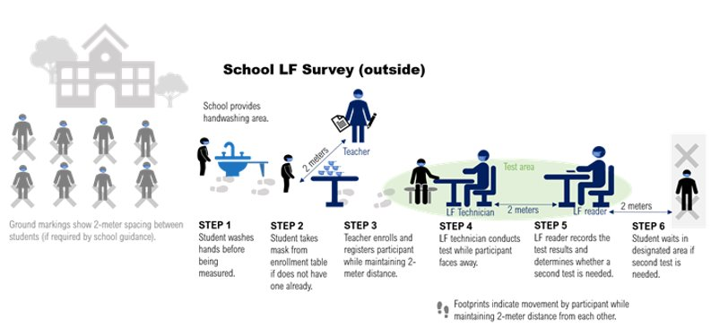
Conducting the examination
*Figure shows community participants WITH MASKS: Choose appropriate figure (present slide or next slide) based on local guidance.

Slide 71
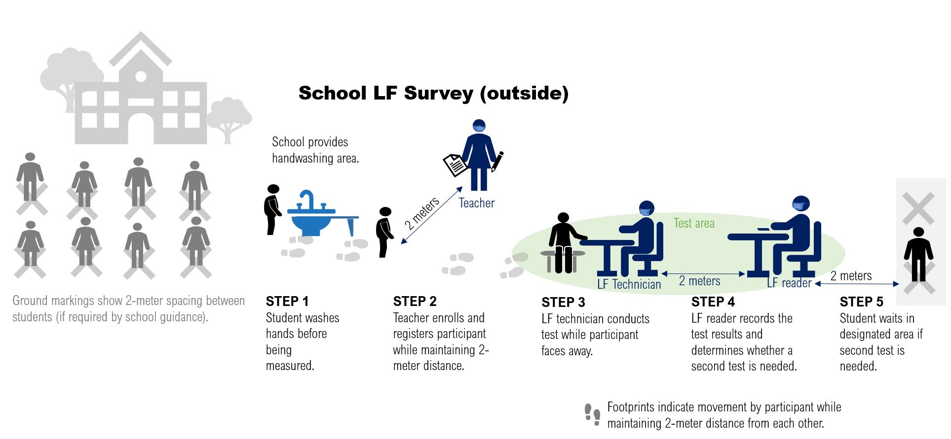
Conducting the examination
*Figure shows community participants WITHOUT MASKS: Choose appropriate figure (present slide or previous slide) based on local guidance.

Slide 72
Questions?

Slide 73
Test your understanding
True or False: Teachers and school personnel should help survey team manage each station.
True
False

Slide 74
Test your understanding
DISCUSSION: Name one way this set-up differs from a regular survey pre-COVID.
Survey team and participants must wear masks at all times
Participants should stay at least 2 meters away from the survey team
All participants must wash hands before testing
Work closely with teachers and school staff to coordinate COVID-19 precautionary measures
Surveys should preferably be conducted outdoors
Participants should face away from blood drawer during testing
Notes:
Participants having to wear masks may be modified or deleted from slide depending on local guidance.

Slide 75
Discussion
What do you think will be the most difficult COVID-19 measure to implement?
Survey team and participants must wear masks at all times
Participants should stay at least 2 meters away from the survey team
All participants must wash hands before testing
Work closely with teachers and school staff to coordinate COVID-19 precautionary measures
Surveys should preferably be conducted outdoors
Participants should face away from blood drawer during testing
Notes:
Participants having to wear masks may be modified or deleted from slide depending on local guidance.

Slide 76
Discussion (2)
How will you deal with groups of curious children who want to gather to see what is going on?
TWO METERS

Slide 77
Let's practice!
As a group, let's role-play this survey set up in the context of COVID-19!

Slide 78
SURVEY SUPERVISION

Slide 79
Supervision in the context of COVID-19
In-person supervision should ideally be delegated to local supervisors as much as possible
Supervisors should:
Follow and implement the infection control measures outlined in the General Survey Protocols slides
Provide immediate feedback to surveyors if observe anything not in line with COVID-19 protocol
Summarize any issues being addressed in regular feedback to own supervisors
Highlight any priority concerns for district- and central-level staff

Slide 80
Survey pre-training: supervision checklist (1)
Is the venue large enough to accommodate the intended number of participants with 2m between?
Are seats, benches, desks arranged 2m apart?
Is the venue well-ventilated? Are windows and doors functioning well and are open?
Is the venue cleaned and disinfected with standard cleaning and disinfectants before participants arrive?
Is shared bathroom cleaned and disinfected with standard cleaning and disinfectants before participants arrive?
Is there a washing area set up and equipped with adequate supply of water and soap at the beginning of the training?

Slide 81
Survey pre-training: supervision checklist (2)
Is there a focal person assigned to monitor all hygiene and sanitation supplies and activities during the event?
Is adequate alcohol-based sanitizer available in areas where water is scarce?
Is there an area designated for COVID-19 screening upon arrival? Do they have a COVID-19 signs and symptoms checklist available to them?
Fever
Visibly apparent symptoms such as cough, shortness of breath, nasal congestion & red eyes
Is there a focal point assigned to manage screening?
Is every attendee wearing a face mask? Is the mask worn properly (covering nose, mouth and chin)?

Slide 82
Survey post-training: supervision checklist (1)
Was the venue cleaned and disinfected with standard cleaning and disinfectants at the end of the day?
Was shared bathroom cleaned and disinfected at the beginning and end of the day?
Were all materials and equipment disinfected after each use?
Did participants wash their hands with soap or use hand sanitizer properly as they went out and returned to the venue for any reason?

Slide 83
Survey post-training: supervision checklist (2)
Was every participant screened for signs and symptoms of COVID-19 using a checklist and thermometer before entering the venue?
If a participant reported COVID-19 symptoms, were they managed following local guidelines?
Were disposable masks properly disposed of in the waste bin after the training?

Slide 84
Survey: supervision checklist (1)
All survey team members were screened for COVID-19 prior to beginning implementation of the survey. If screening was positive, surveyors did not continue to work and were sent home to isolate.
Survey team followed local guidelines regarding traveling to the survey site.
Survey was done outside. If this was not possible, describe the extra precautions taken.
Appropriate communication was given to participants before survey, including information on COVID-19 safety precautionary measures and how those would be applied during this visit.

Slide 85
Survey supervision checklist (2)
Survey team members washed hands thoroughly before interacting with community members.
Participants washed hands before and after their blood sample was taken.
Survey team members always wore face masks. Surveyors wore gloves when conducting FTS.
Two meters distance was maintained between survey team members and participant at all times except during blood sample.
Survey equipment was disinfected with alcohol-based before each participant and after contact with participants.
Survey results were accurately recorded and communicated
Notes:
Depending on local guidance, could also add questions about participants mask wearing and/or crowd control.

Slide 86
Questions?

Slide 87
ACKNOWLEDGMENTS
This presentation is made possible by the generous support of the American People through the United States Agency for International Development (USAID). The contents are the responsibility of Act to End NTDs | East, led by RTI International in partnership with The Carter Center, Fred Hollows Foundation, IMA World Health, Light for the World, Sightsavers, Results for Development, Save the Children, and WI-HER under cooperative agreement No. 7200AA18CA00040 and do not necessarily reflect the views of USAID or the United States Government.

